Slide 1
Loan prediction using Machine learning
Classification using Logistic Regression

Slide 2
Problem Statement :
A Finance company deals in all home loans. They have presence across all urban, semi urban and rural areas. Customer first apply for home loan after that company validates the customer eligibility for loan. Company wants to automate the loan eligibility process (real time) based on customer detail provided while filling application form. These details are Gender, Marital Status, Education, Number of Dependents, Income, Loan Amount, Credit History and others. To automate this process, they have given a problem to identify the customers segments, those are eligible for loan amount so that they can specifically target these customers.

Slide 3
Why we need Machine learning to solve this problem ?
It learns from data…….

Slide 4
What is Machine Learning ?
Machine learning is a method of data analysis that automates analytical model building.
Using algorithms that iteratively learn from data, machine learning allows computers to find hidden insights without being explicitly programmed where to look.

Slide 5
What is Machine Learning ?
Traditional approach
Input
Output
Computation
Program
Machine learning approch
Input
Computation
Program
Output

Slide 6
Machine Learning
Formalization
Input : x ( Customer details / Features )
Output : y ( Potential customer or not )
Target function : f : x y ( ideal approval formula / always unknown )
Data : (x1,y1) (x2,y2) (x3,y3) ………(xn,yn) ( historical records )
Hypothesis : g: x y

Slide 7
In our problem :
Input x : {Gender, Marital Status, Education, Number of Dependents, Income, Loan Amount, Credit }
Output y : { Loan status }

Slide 8
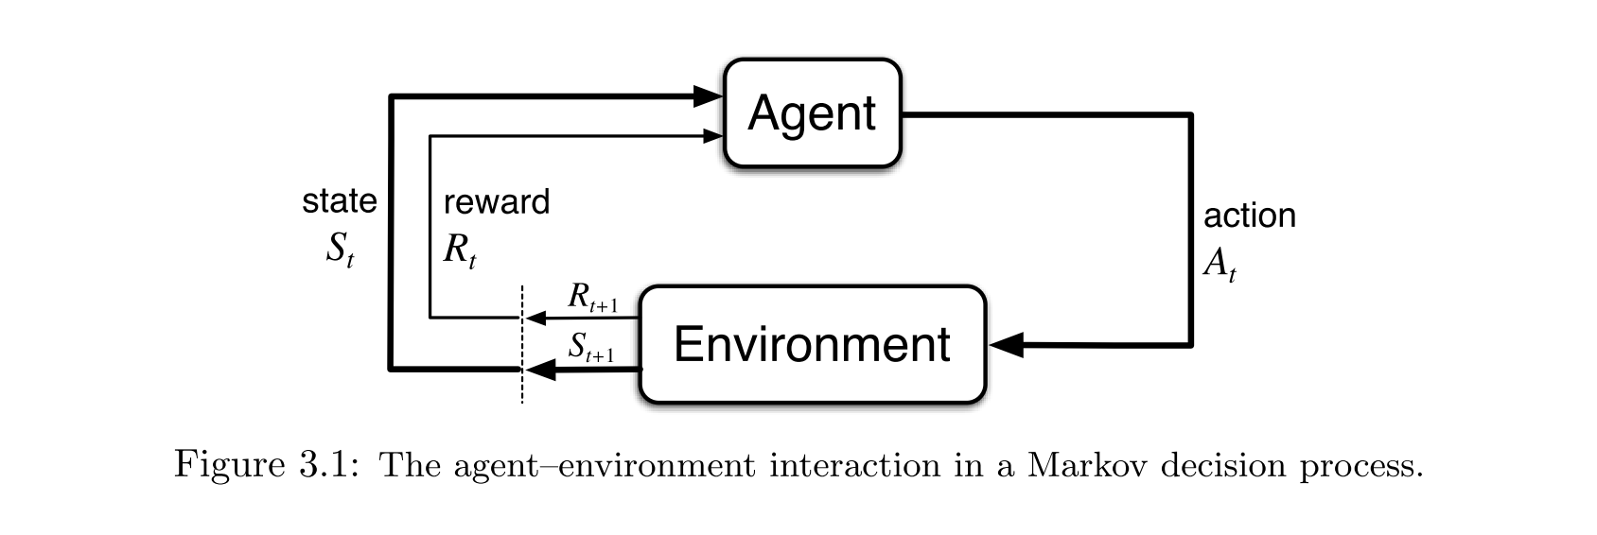
Types of Machine learning
Supervised learning : Task driven( Regression / Classification )
labeled data ( x, y )
Supervised learning is commonly used in applications where historical data predicts likely future events .
Unsupervised learning : Data driven ( Clustering )
Unlabeled data ( x )
The goal is to explore the data and find some structure within .
Reinforcement learning : Algorithm learns to react to an inviroment

Slide 9
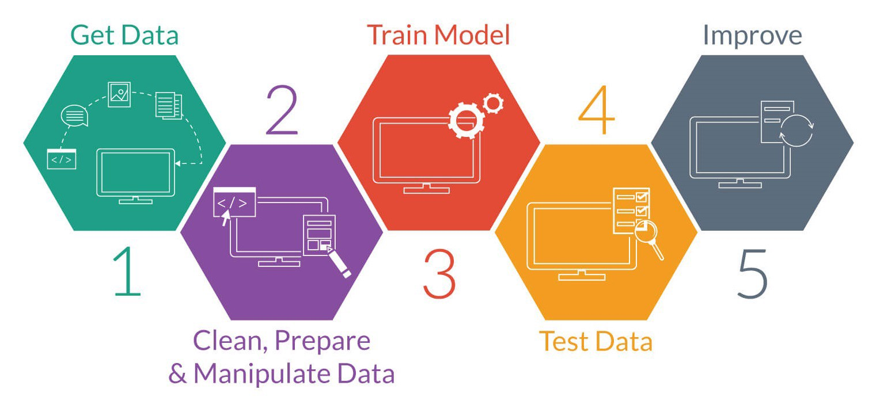
Machine learning process

Slide 10
1. Get and explore data
If you have no data then there is no machine learning .
90% of world’s digital data is generated in last two years .
Dataset used in this problem is from data science website kaggle.com
Let’s have a look on our dataset……..

Slide 11
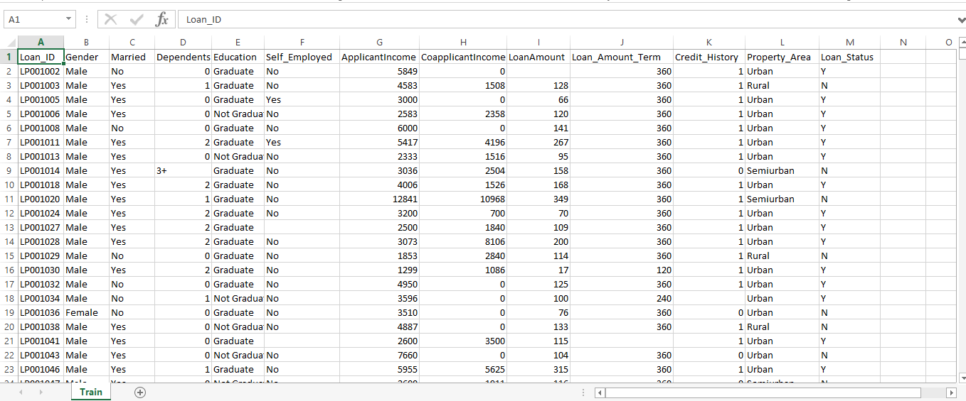
Train.csv ( Historical data )

Slide 12
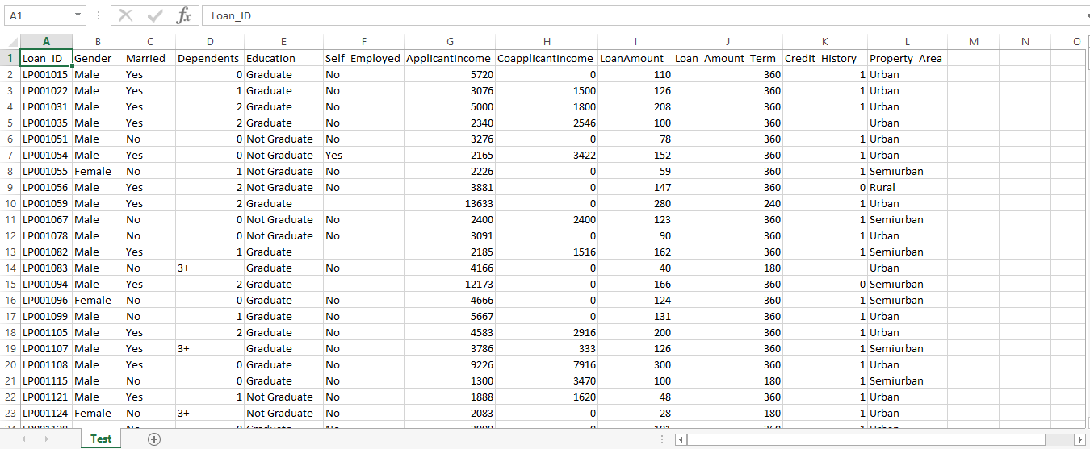
Test.csv ( New applicant )

Slide 13
Explore data
Best way to explore any data is by visualizing it .
Our training dataset is size of 614 12 .
We use pre-build python libraries for visualizing data
Matplotlib.pyplot
Seaborn
Some important results from our dataset after visualizing it…..

Slide 14
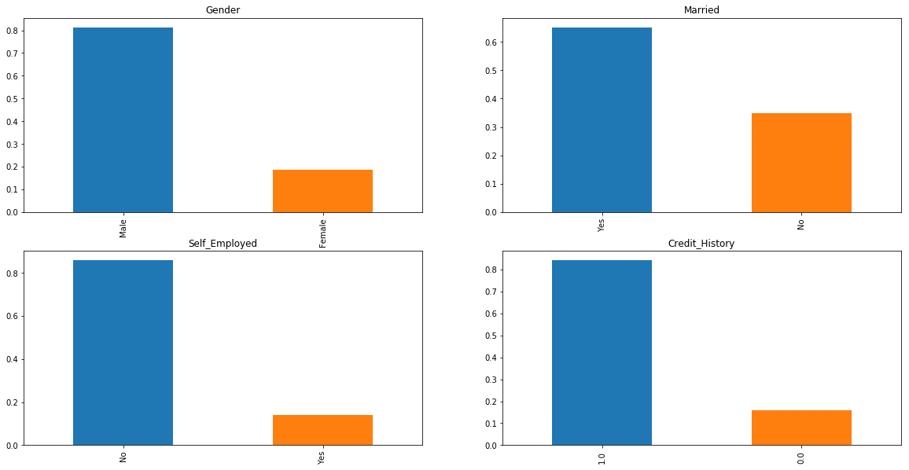
Some common facts

Slide 15
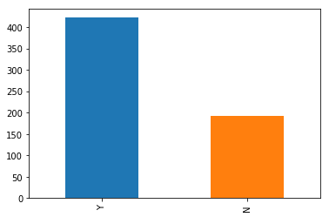
Value count of Loan_Status

Slide 16
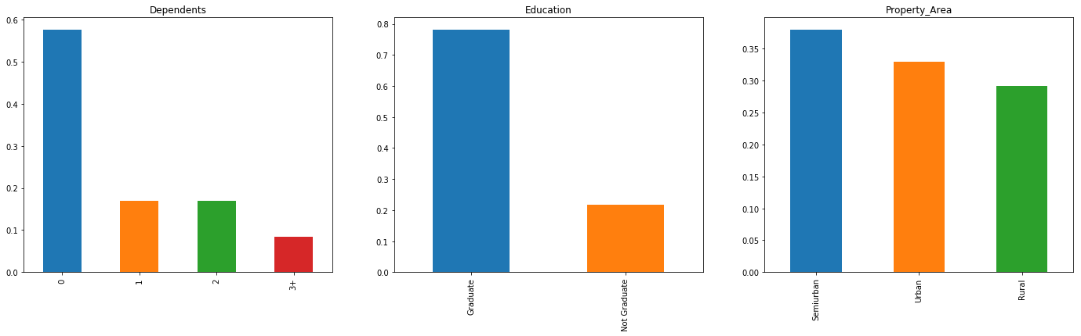
Graphical representation of some features

Slide 17
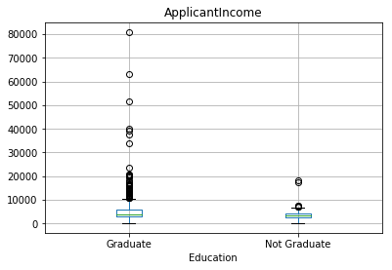
Boxplot ApplicantIncome vs Education

Slide 18
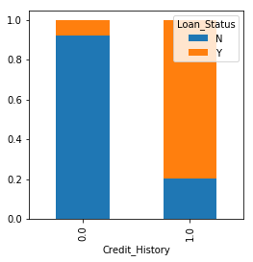
Credit_History vs Loan_Status

Slide 19
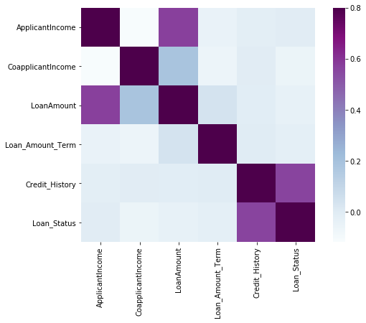
Correlation plot

Slide 20
2. Clean, prepare, manipulate data
Remove extra features
Remove correlated features
Fill missing values

Slide 21
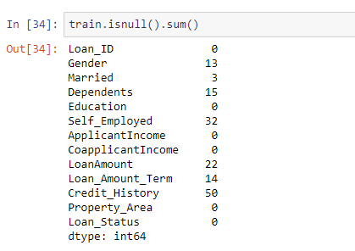
Missing values

Slide 22
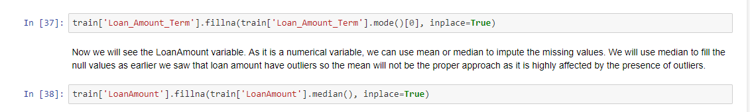
Missing values Treatment
We can use a lot of methods to fill missing values.
If feature is a real value then we can take average/mean of it to fill missing values.
If feature a is categorical and 70 – 80 % belongs to one class then we can assign rest of missing values to dominant class.

Slide 23
3. Train Model
Our problem is a type of binary classification.
So we can use Logistic Regression to solve it.

Slide 24
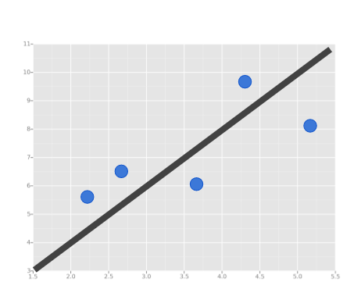
Linear Regression
In linear regression we try to find out best line , to fit our data.

Slide 25
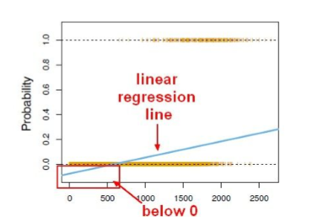
Logistic Regression
We can’t use normal linear regression model on binary groups. It won’t lead to a good fit .

Slide 26
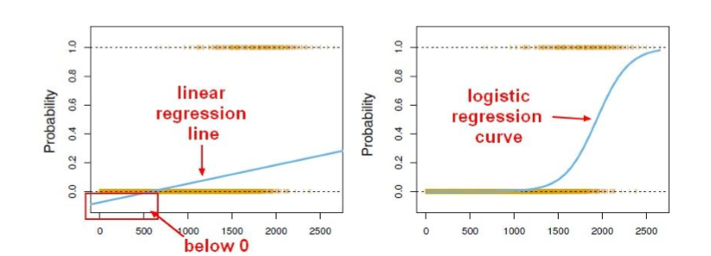
Instead we can transform our linear regression to a logistic regression curve.

Slide 27
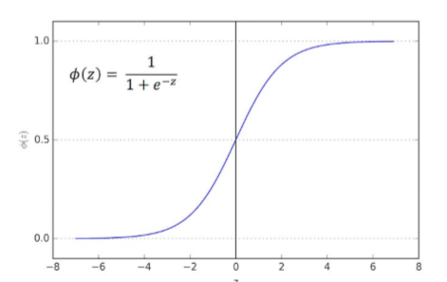
The sigmoid ( aka logistic ) function takes in any value and output it to be between 0 and 1.

Slide 28
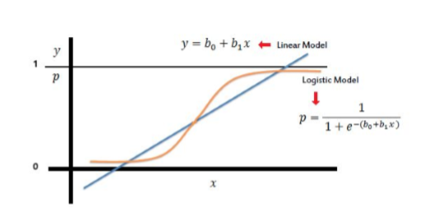
This mean we take our linear regression solution and place it into the sigmoid function.

Slide 29
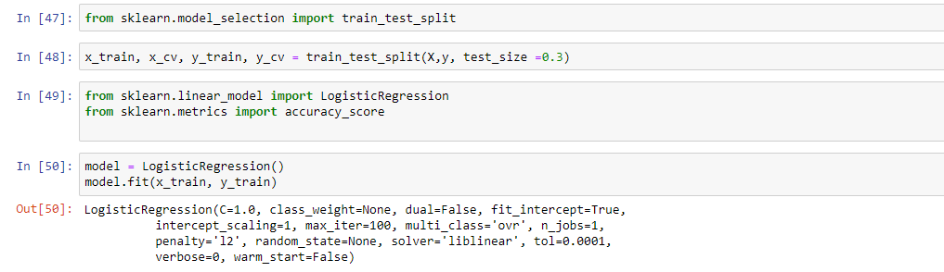
Train Model
We use sciket-learn library to implement logistic regression.

Slide 30
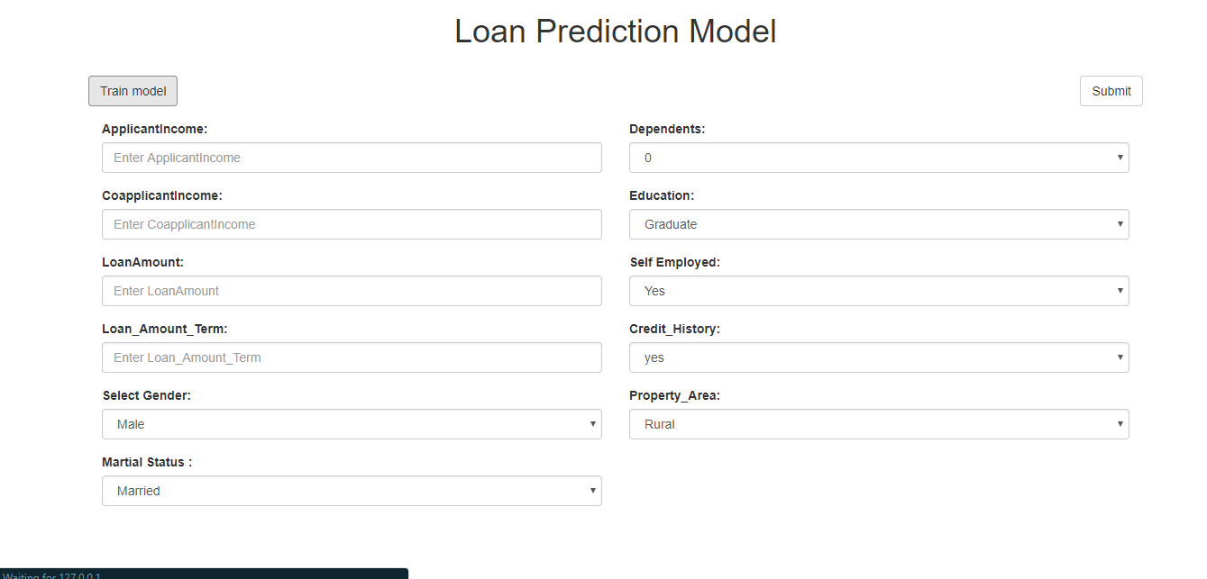

Slide 31
Thank you
Vaibhav kumar
Aman sharma

